Slide 1
NUCLEAR DATA COVARIANCE ANALYSIS OF AN ENERGY TUNING ASSEMBLY FOR SIMULATING NUCLEAR WEAPON ENVIRONMENTS
Capt Nick Quartemont
MS Nuclear Engineering 19M
Air Force Institute of Technology
31 January 2019

Slide 2


Motivation
2018 Nuclear Posture Review “deterring state support for nuclear terrorism through advanced forensics and attribution capabilities.”
Create accurate surrogate nuclear weapon neutron environment
Addresses deterrence and non-proliferation capability gaps:
Attribution and device reconstruction
Certification and testing
Notes:
The 2018 U.S. National Defense Strategy identied the modernization of the nu-
clear triad as a key capability to meet requirements [3]. Therefore, there is still a need
for the capabilities previously provided through nuclear testing for the study of nu-
clear environments to support the credibility of the nuclear deterrent. Previous work
has shown that the loss of nuclear testing has created a capability gap to reproduce
nuclear weapon environments of interest to national security applications including
nuclear weapons effects (NWE) and technical nuclear forensics (TNF).

Slide 3
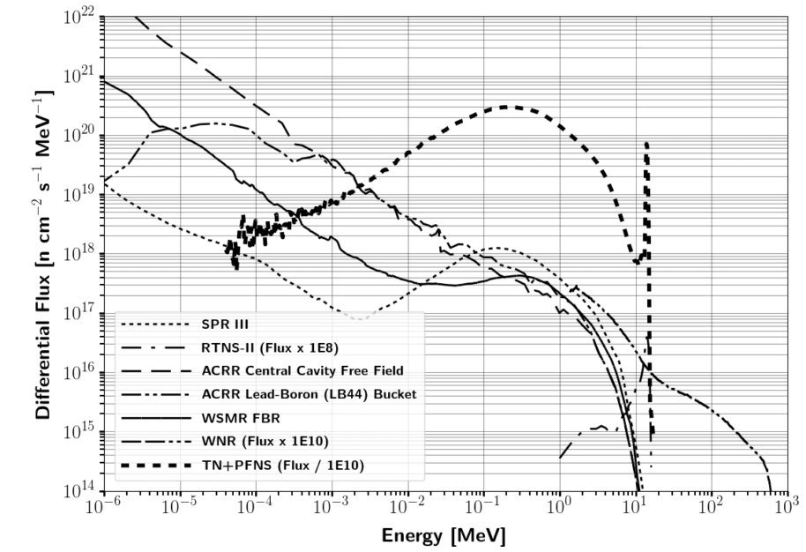
Capability gap in reproducing nuclear weapon environments
Notes:
A key consideration for testing is the neutron energy spectrum in comparison with the environment that a nuclear weapon would see or produce.
A particular spectrum of interest is the combination of a thermonuclear (TN) and prompt fission neutron spectrum (PFNS) as the present testing does not address this region to a large extent.
The vast majority of testing facilities are focused on the Watt-fission spectrum, while a few are capable of producing the 14.1 MeV TN component from the deuterium-tritium (DT) fusion process\cite{Bridgman}.
The current prompt neutron facilities available are not well suited for the TN+PFNS application testing because of the lack of high energy neutrons, or there is not a large enough flux of neutrons on target.
Several examples of testing facilities for prompt neutrons outlined in Table \ref{tab:NWECap} are the Sandia Pulsed Reactor III (SPR), Sandia Annual Core Research Reactor (ACCR), White Sands Missile Range (WSMR) Fast Burst Reactor (FBR), and the Los Alamos National Laboratory (LANL) Rotating Target Neutron Source (RTNS).
The differential spectral profile of these sources compared to a notional TN+PFNS is shown in Figure \ref{fig:CompSource}. the LANL Weapons Neutron Research facility (WNR).

Slide 4
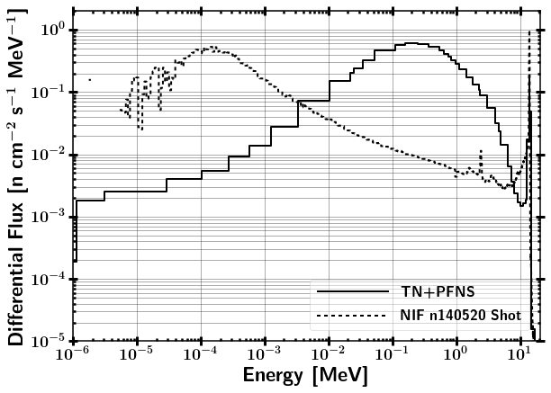
ETA Research Objective
Can an accurate neutron energy distribution expected from a "typical" thermonuclear or boosted nuclear weapon detonation be produced using spectral modification at the NIF?

Slide 5
Research Problem
FY 2019 NIF Shot
Quantify the impact of nuclear data covariance
Design a foil activation diagnostic pack to provide better resolution in the epithermal neutron energy range
Prioritize and estimate production of fission products for radio-chemical analysis
Evaluate ETA as potential capability as a short pulse neutron source (SPNS)

Slide 6
Assumptions and Limitations
Nuclear data
Uncertainty in the uncertainty
Uncertainty follows a multivariate normal distribution
Unclassified nuclear weapon spectrum – Thermonuclear and Prompt Fission Neutron Spectrum (TN+PFNS)
NIF neutron source operational
Nuclear weapon environment
Not analyzed at weapon temperatures
No temporal or volume dependence
No fractionation
Representative internal weapon spectrum

Slide 7
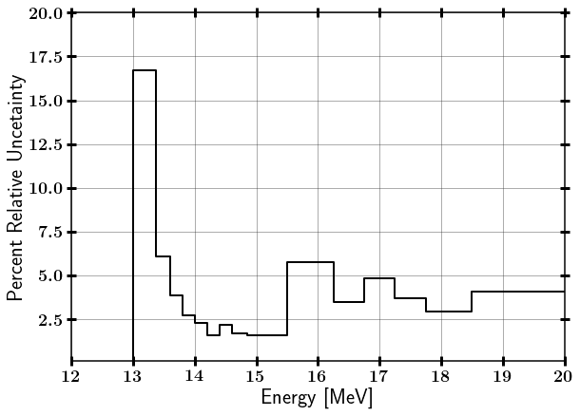
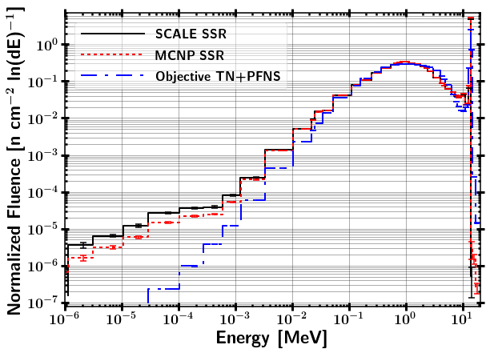
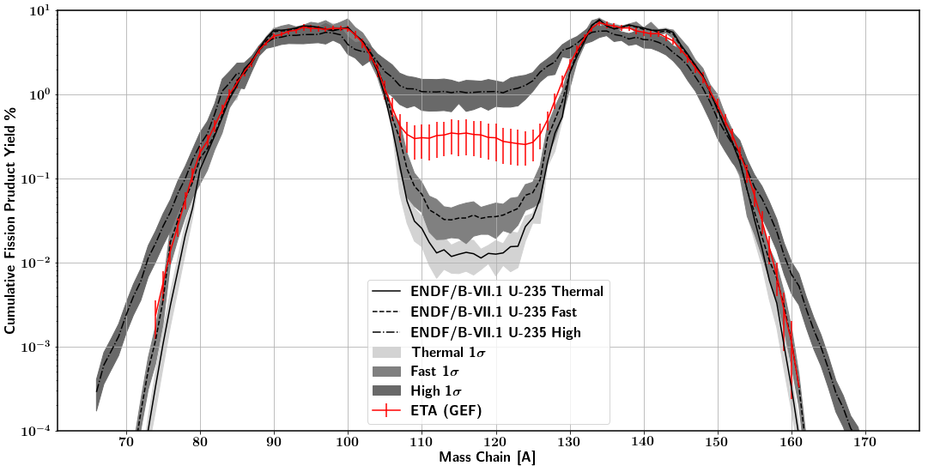
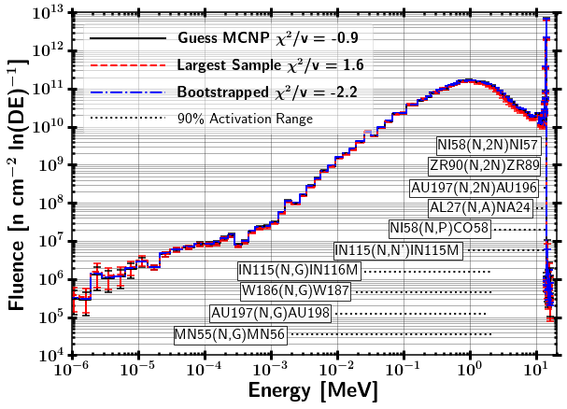
Summary of Main Theory Utilized
Nuclear Data Covariance and Statistical Bootstrapping
Neutron Interactions with Matter
Monte Carlo Neutron Transport
Fission Theory Fission Products
Foil Activation and Neutron Energy Spectrum Unfolding

Slide 8
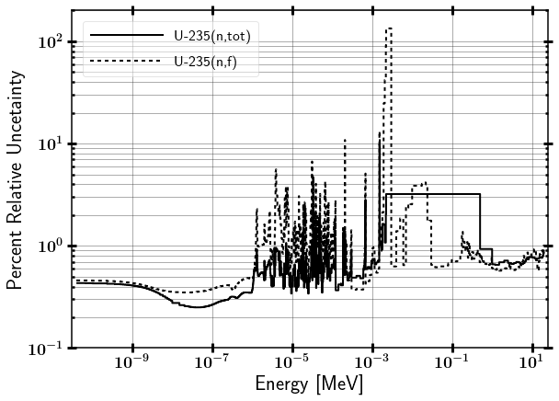
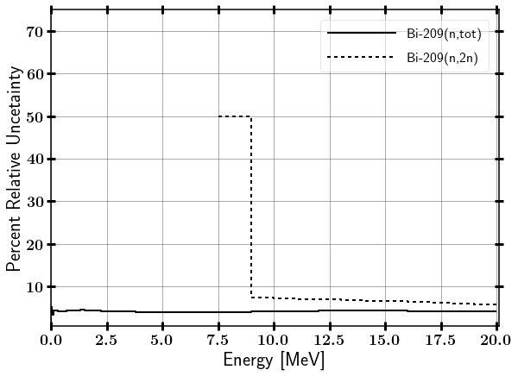
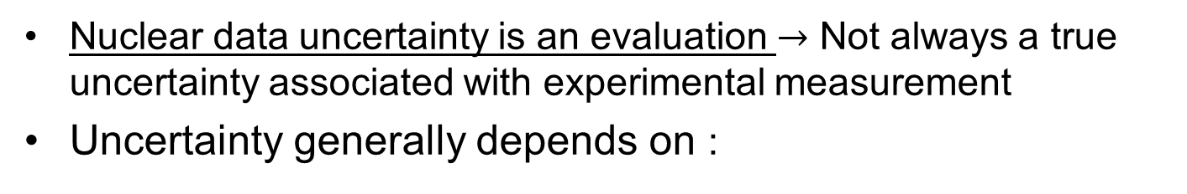
Nuclear Data Uncertainty
Nuclear data uncertainty is an evaluation $→$ Not always a true uncertainty associated with experimental measurement
Uncertainty generally depends on :
Cross-section magnitude
Total verse component reaction
Neutron energy range
Application space

Slide 9
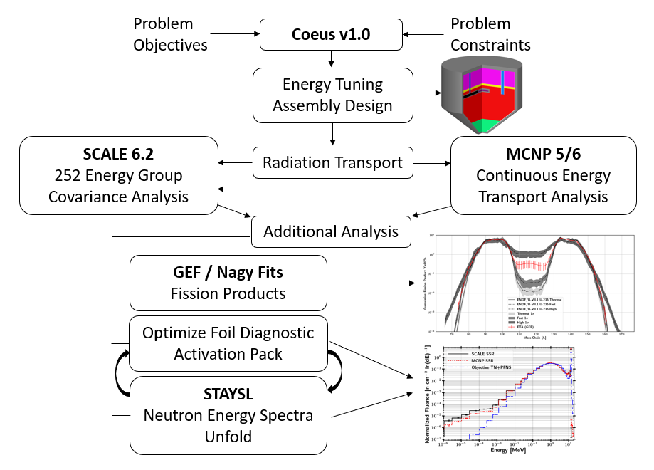
Methodology

Slide 10
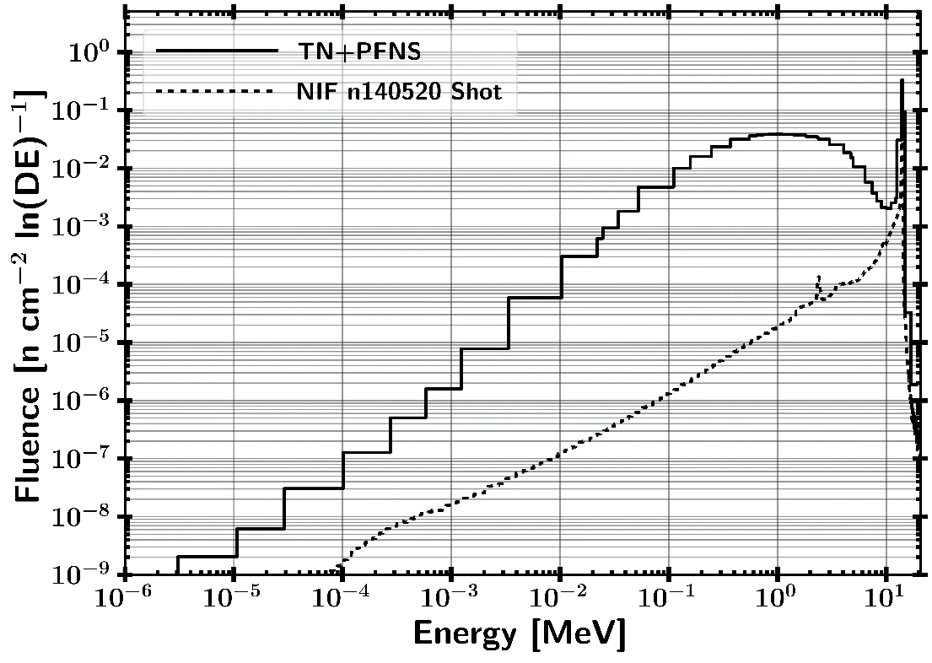
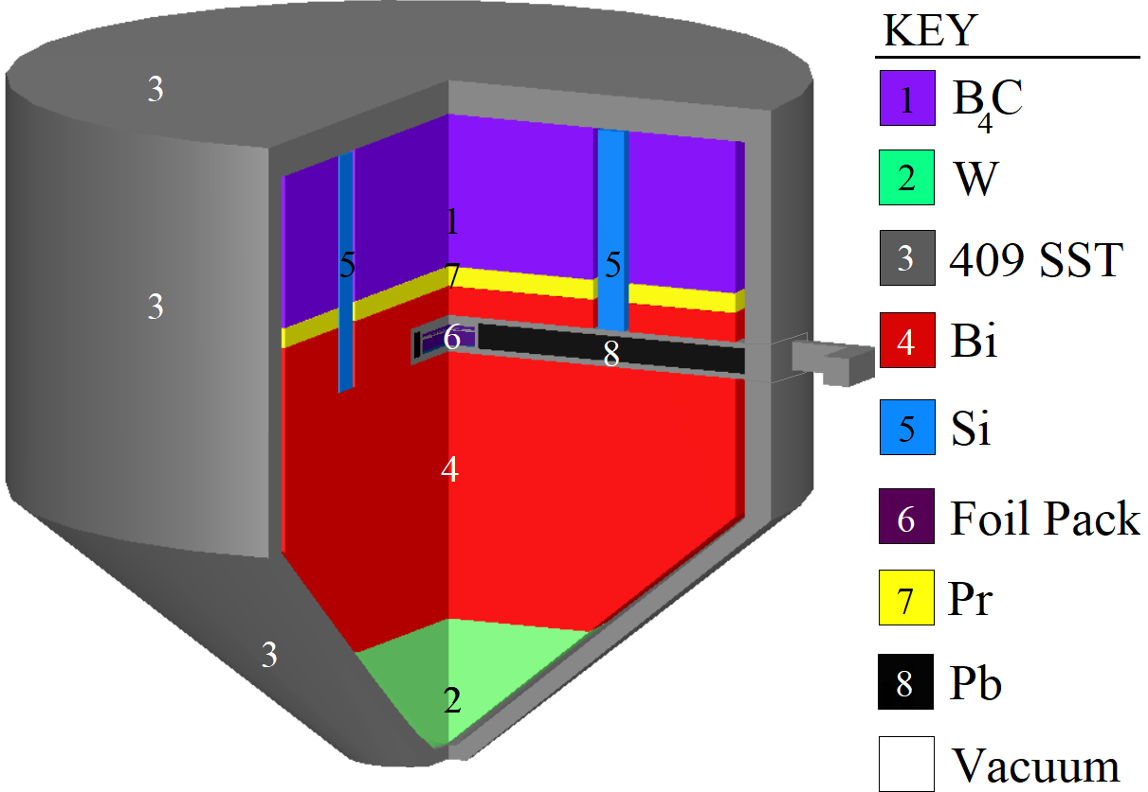
ETA Design Overview
15 cm
Foil Pack Contains
HEU
Au, Zr, Ni, Al, In, W, Mn
NIF SOURCE

Slide 11
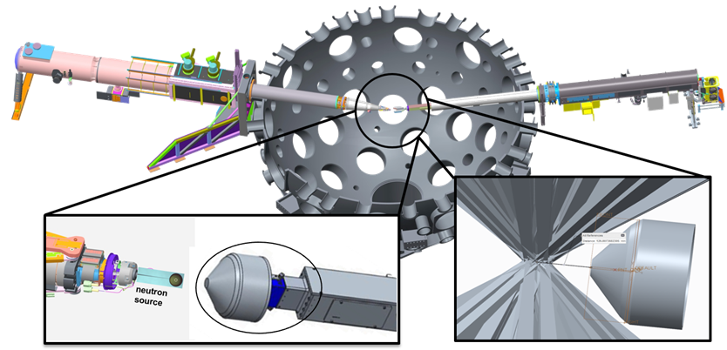
Experimental Overview and Full NIF Model
Modeled Polar Drive Exploding Pusher (PDXP) Deuterium-Tritium neutron source
3.7 x 10¹⁵ 14 MeV neutron yield
Minimal downscatter compared indirect drive methods utilizing a hohlraum
NIF Neutron Source with Mounted ETA Incident Laser Exclusion Zone
Notes:
including the target positioner (TARPOS), Target and Diagnostic Manipulator (TANDM) with ETA and diagnostic snout, polar diagnostic instrument manipulator (DIM), and target chamber with first panel walls

Slide 12
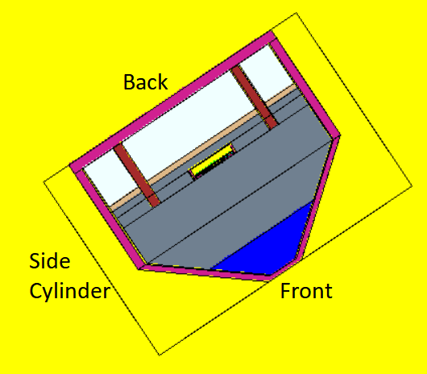
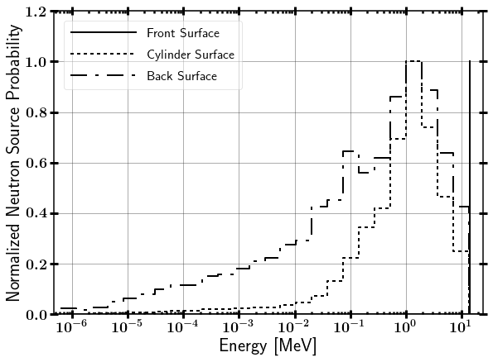
Modeled NIF Neutron Source Term
Surface Source Read file from LLNL
Contains NIF “room return”, which accounts for less than 1% of source neutrons on ETA.
Modeled as 14.03 MeV point source

Slide 13
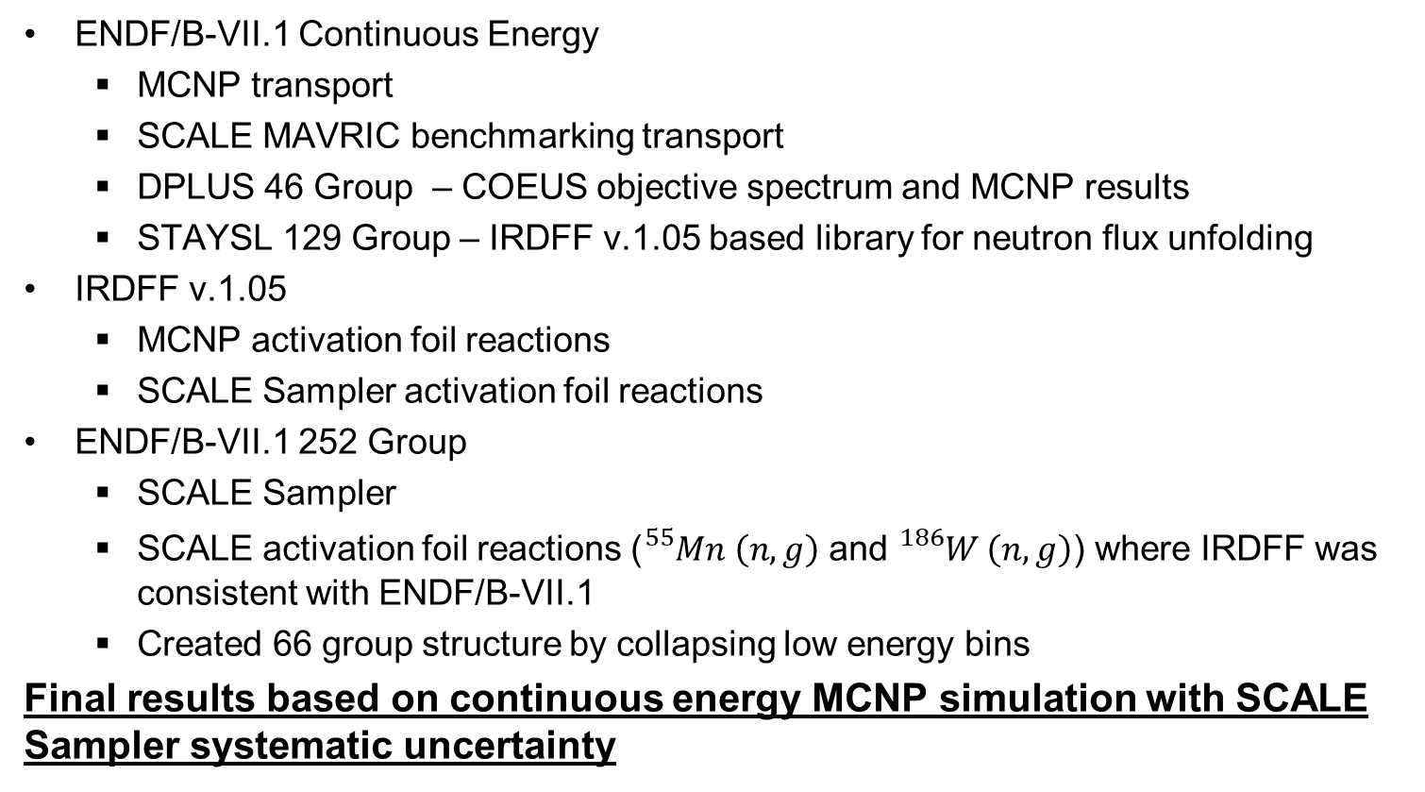
Nuclear Data Libraries Utilized
ENDF/B-VII.1 Continuous Energy
MCNP transport
SCALE MAVRIC benchmarking transport
DPLUS 46 Group – COEUS objective spectrum and MCNP results
STAYSL 129 Group – IRDFF v.1.05 based library for neutron flux unfolding
IRDFF v.1.05
MCNP activation foil reactions
SCALE Sampler activation foil reactions
ENDF/B-VII.1 252 Group
SCALE Sampler
SCALE activation foil reactions (${}_{}^{55}{Mn} \left(n,g\right)$ and ${}_{}^{186}W \left(n,g\right)$) where IRDFF was consistent with ENDF/B-VII.1
Created 66 group structure by collapsing low energy bins
Final results based on continuous energy MCNP simulation with SCALE Sampler systematic uncertainty

Slide 14
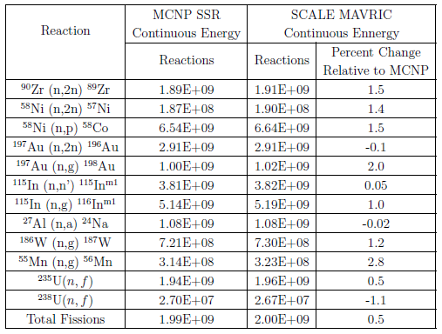
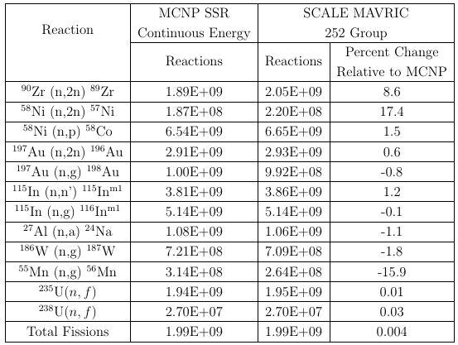
Benchmarking Reactions from MCNP SSR Mapped to SCALE 252 Group Structure
MCNP SSR $→$ MAVRIC continuous energy mapped
$→$ MAVRIC 252 group
Difference between MCNP and continuous energy MAVRIC consistent with studies performed in literature.
There was not a large systematic difference.
Difference between MCNP and 252 group MAVRIC dominated by group structure.
Larger systematic difference was in high energy threshold reactions.

Slide 15
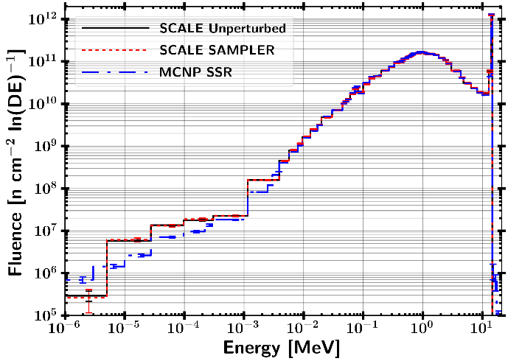
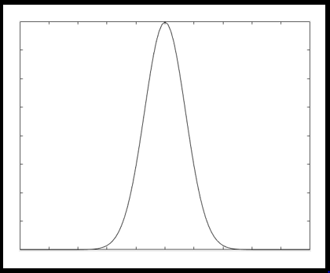
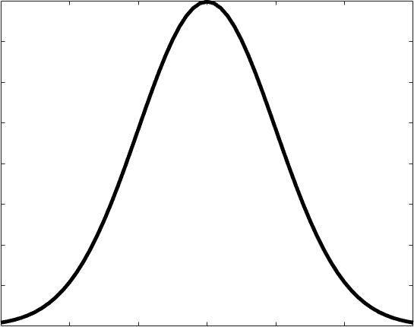
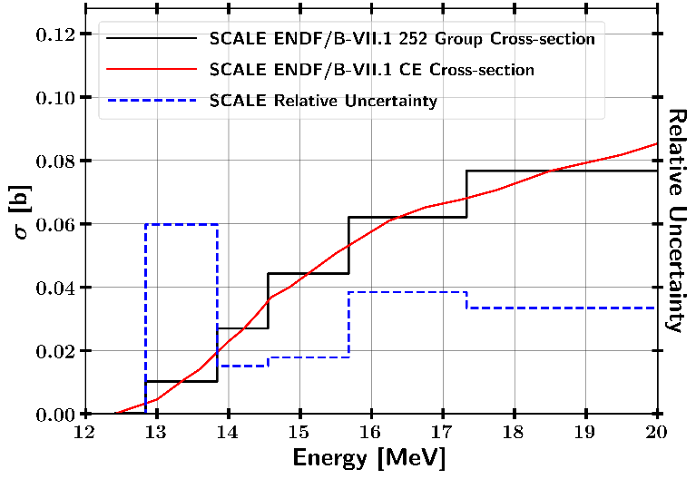
Sampling Nuclear Data
Covariance Libraries
Uncertainty from
Statistical
Neutron transport
Foil activation data
SCALE Sampler Module (Neutron Transport)
Unperturbed
Response
N Perturbed Sampled Responses
IRDFF Nuclear Data Covariance
Perturbation
Combine with Statistical Bootstrapping
Continuous Energy Statistical Uncertainty
Ni-58 (n,2n)
Final response with statistical, neutron transport, and reaction cross-section uncertainties
15
15

Slide 16
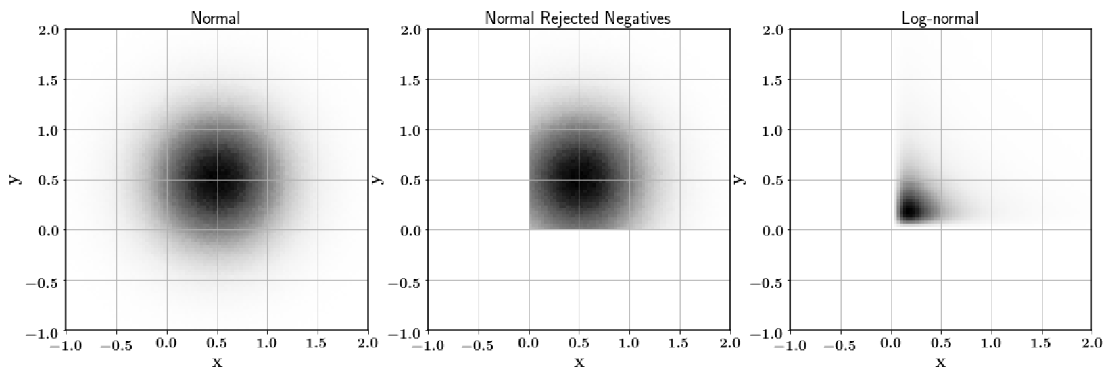
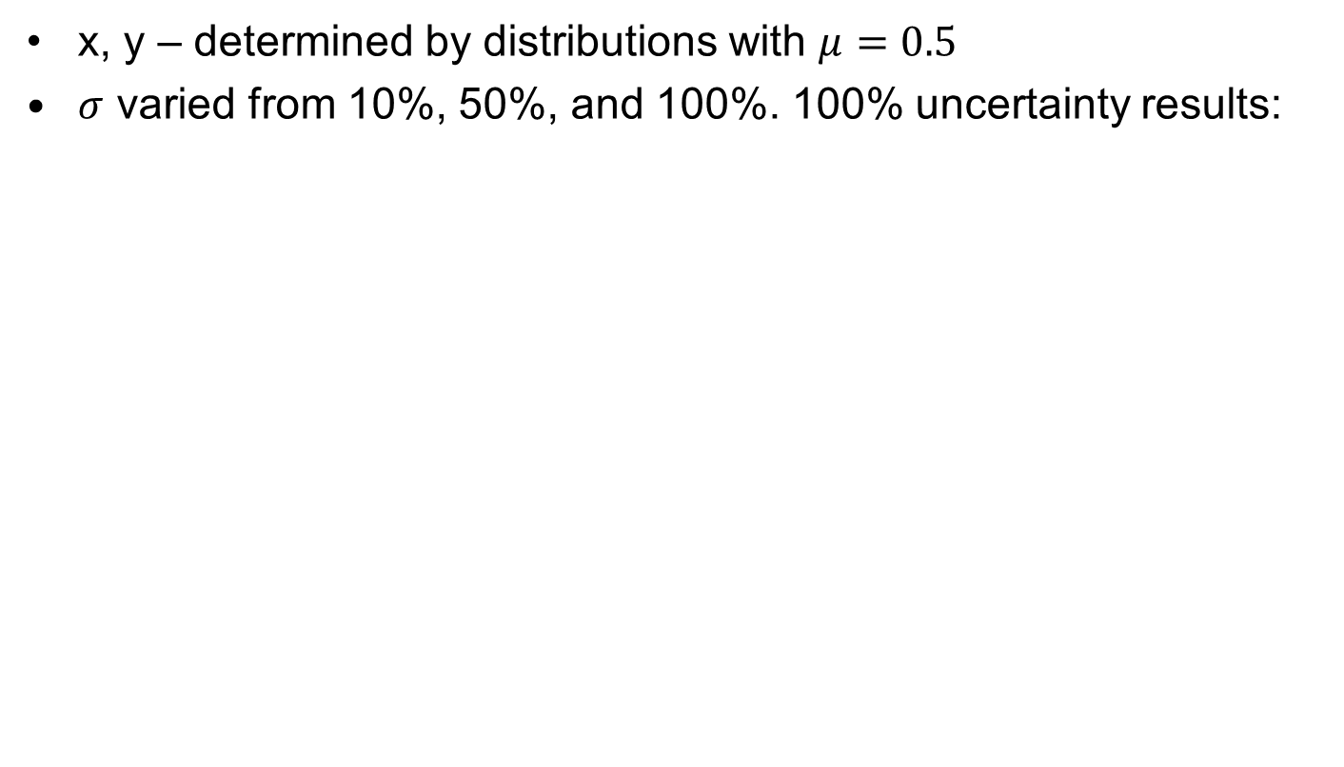
Log-normal vs. Normal Monte Carlo Darts Case Study
x, y – determined by distributions with $μ=0.5$
$σ$ varied from 10%, 50%, and 100%. 100% uncertainty results:
Log-normal distribution allows for a more appropriate and physical (non-negative) distribution of the data.
Normal distribution with negative numbers removed is the current approach of stochastic sampling radiation transport methods

Slide 17
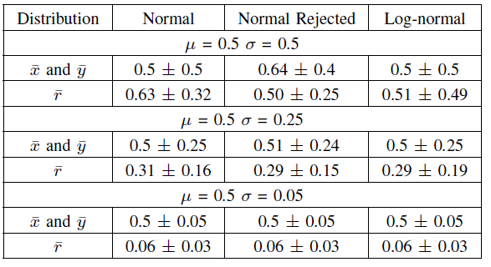
Log-normal verse Normal Monte Carlo Darts Case Study
Normal is appropriate up to approximately 0 to 50% uncertainty.
Nuclear data uncertainty goes above 50% in ETA problem; however, this is generally where the cross-section is low.

Slide 18
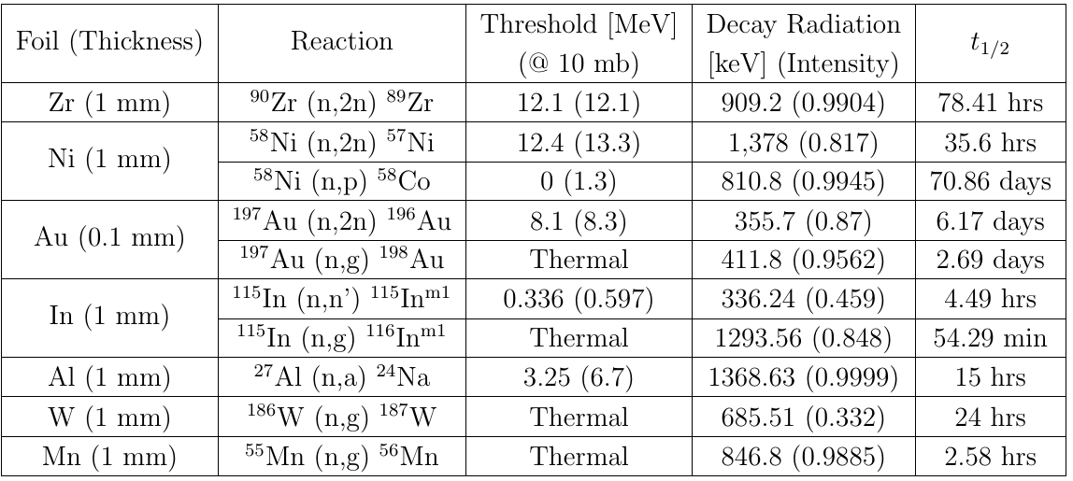
Activation Foil Selection
Cd, Cu – Multiple reaction channels with same product
Nb, Eu, Dy, Sm, Se, Er, Ir – Large activation uncertainty in energy range
Zr – Nearly equivalent to Al
Sc, As, Co, Nb – Low activity at 2 hrs
Fe – Low abundance of isotope of interest
Primary Selection Criteria
IRDFF/Nuclear data 3) Foil activity at 2 to 12 hours
Energy range of activation 4) Strong decay gamma-ray emission

Slide 19
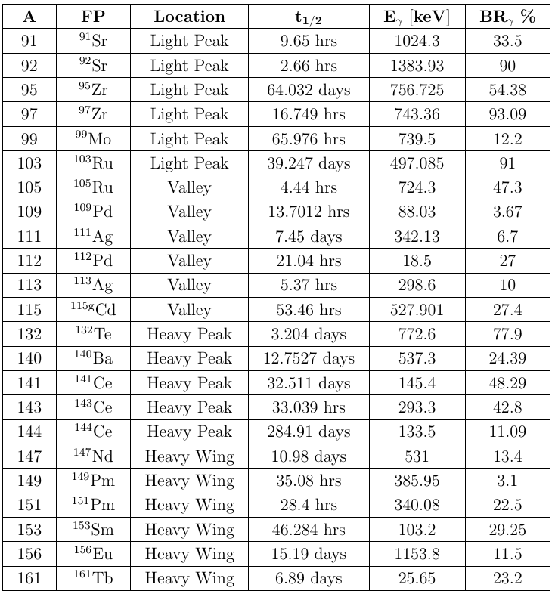
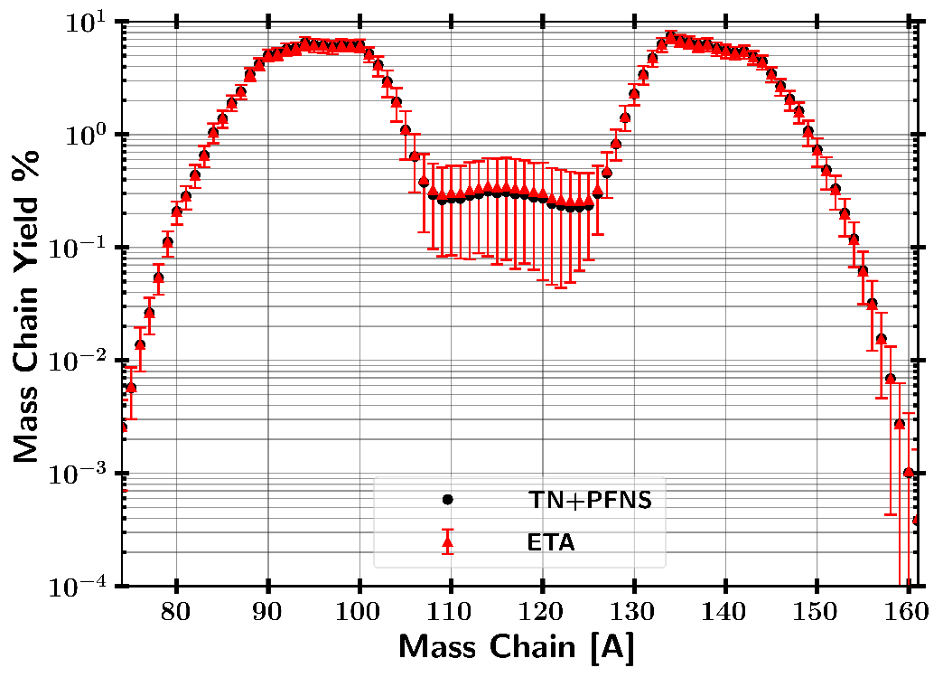
Selected Fission Products for Analysis
Light
Peak
Heavy
Peak
Valley
Heavy
Wing

Slide 20
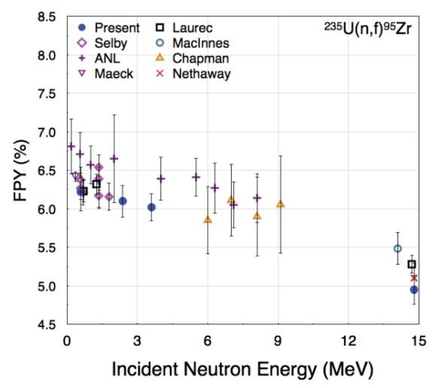
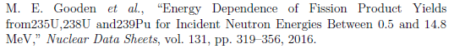
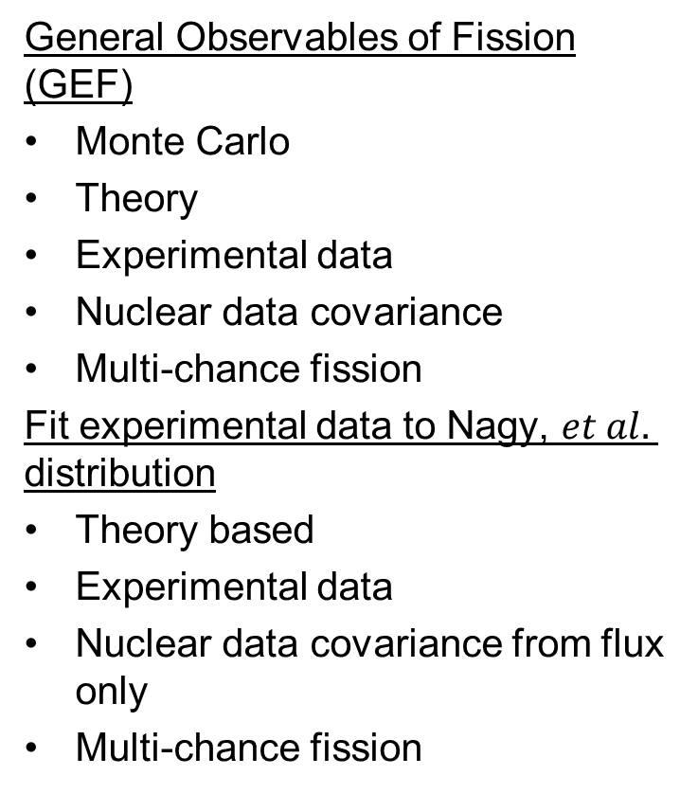
Fission Product Yield Estimation Techniques
General Observables of Fission (GEF)
Monte Carlo
Theory
Experimental data
Nuclear data covariance
Multi-chance fission
Fit experimental data to Nagy, $et al.$ distribution
Theory based
Experimental data
Nuclear data covariance from flux only
Multi-chance fission

Slide 21
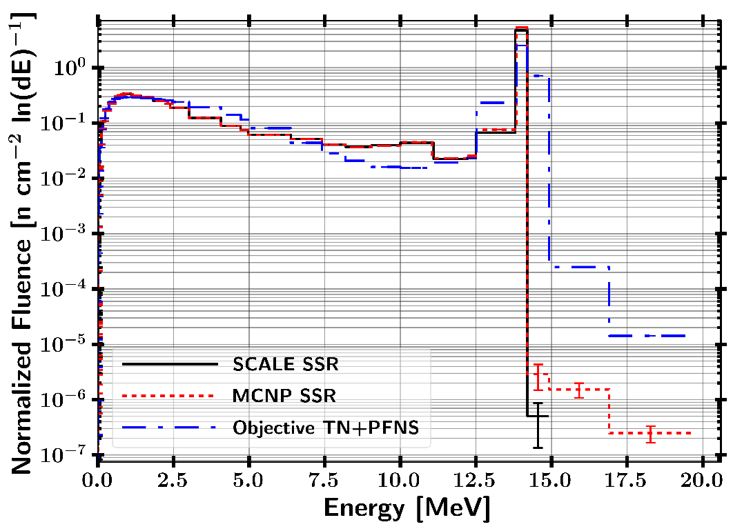
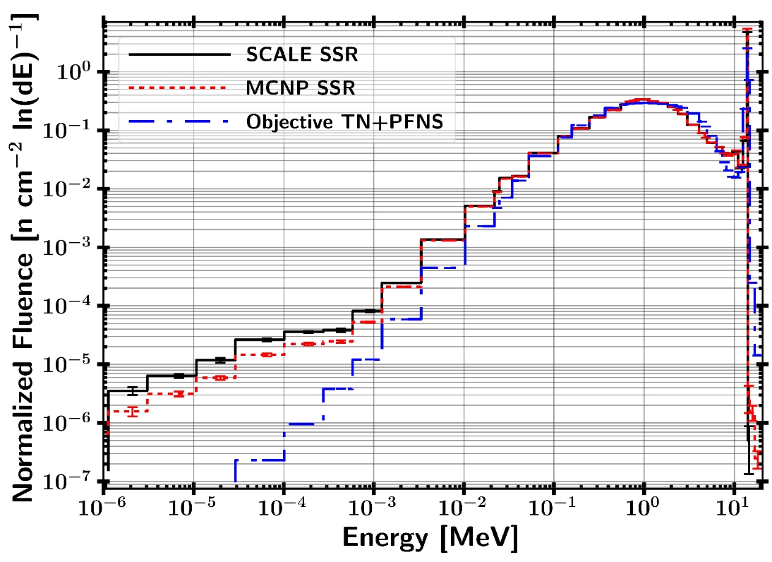
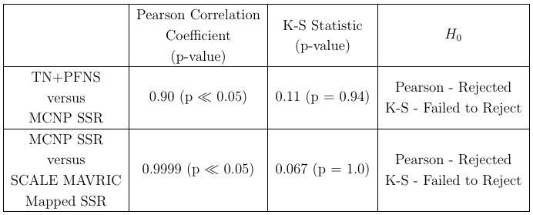
ETA Neutron Spectrum Performance Continuous Energy Results
Neutron spectrum achieved by ETA is consistent with the objective TN+PFNS.

Slide 22
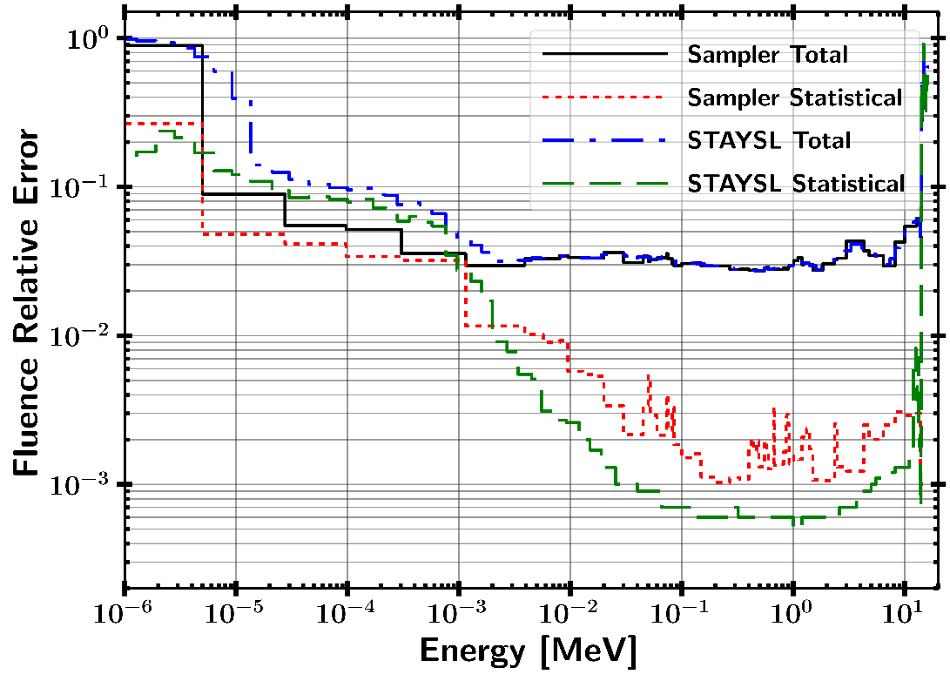
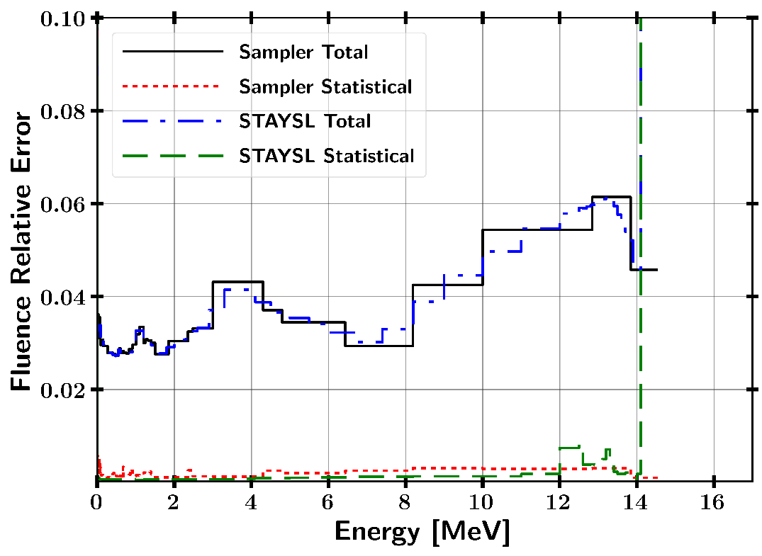
Neutron Fluence Uncertainty

Slide 23
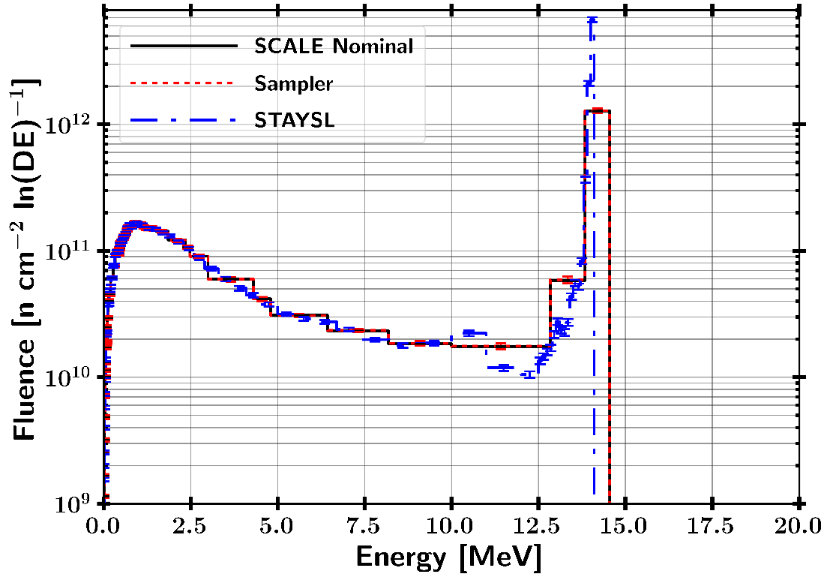
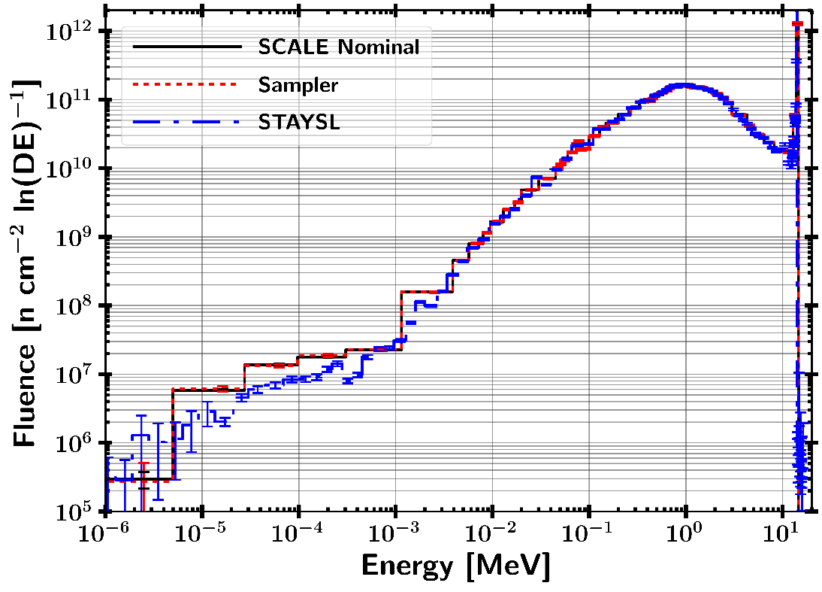
Neutron Fluence Uncertainty Mapped to STAYSL 129 Group Structure
Guess neutron spectrum for neutron fluence unfolding with STAYSL.
Mean value from MCNP CE
Uncertainty mapped from SCALE Sampler

Slide 24
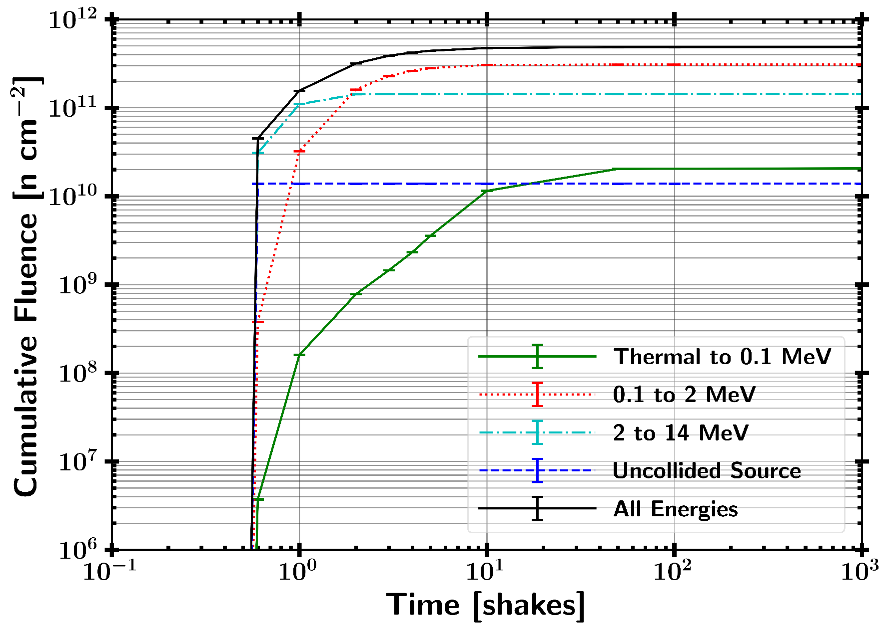
Neutron Fluence Timing Profile

Slide 25
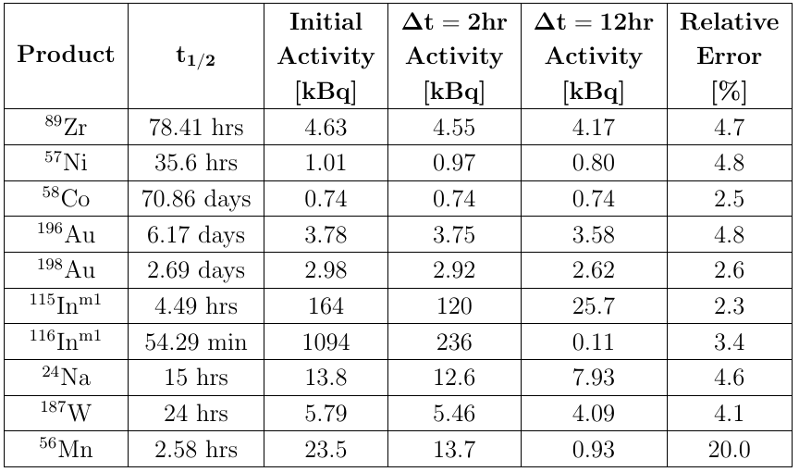
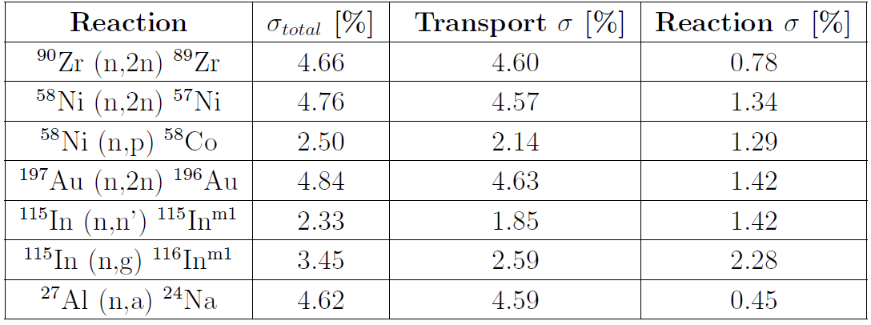

Activation Foil Results
$$R∝σ_{rxn}φ →\frac{σ_{R}}{R}=\sqrt{{\left(\frac{σ_{φ}}{φ}\right)}^{2}+{\left(\frac{σ_{σ_{rxn}}}{σ_{rxn}}\right)}^{2}}$$
All activities are usable for counting statistics.
Main risks are Mn and In reactions which have short half-life.

Slide 26
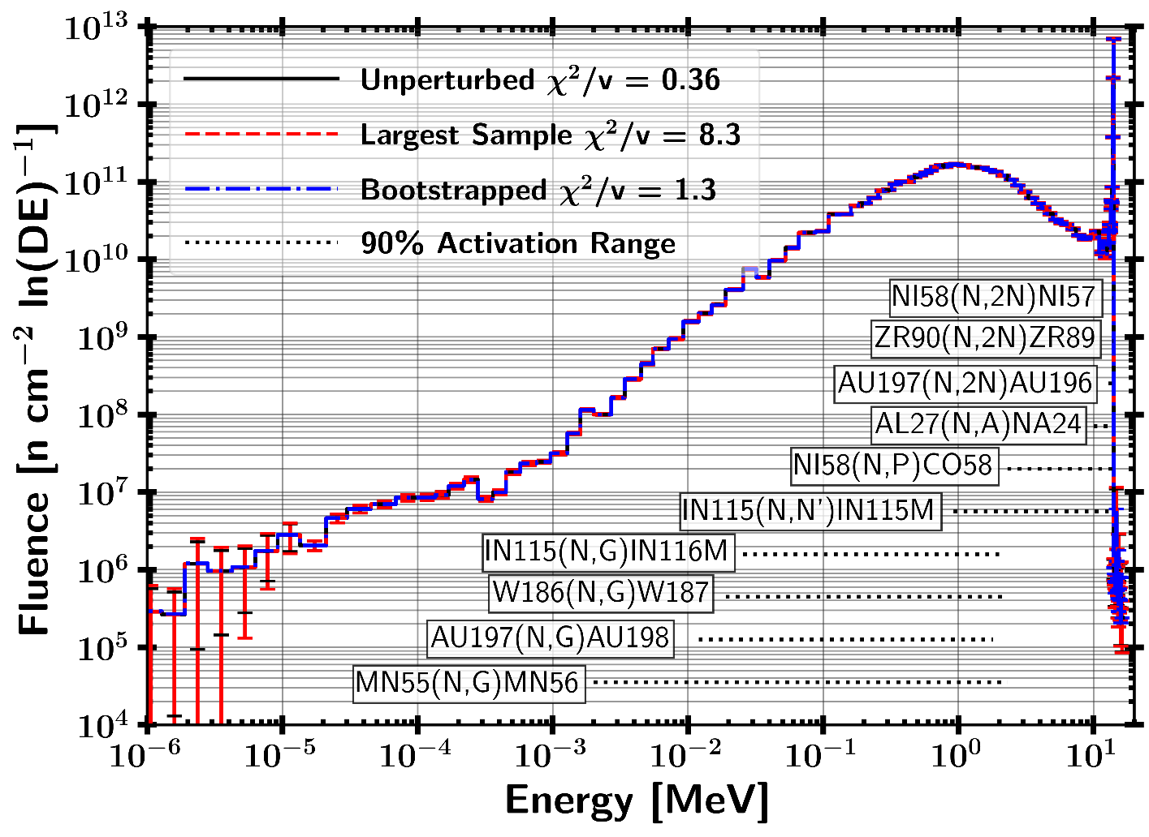
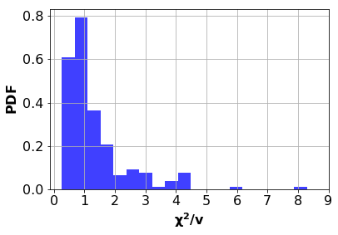
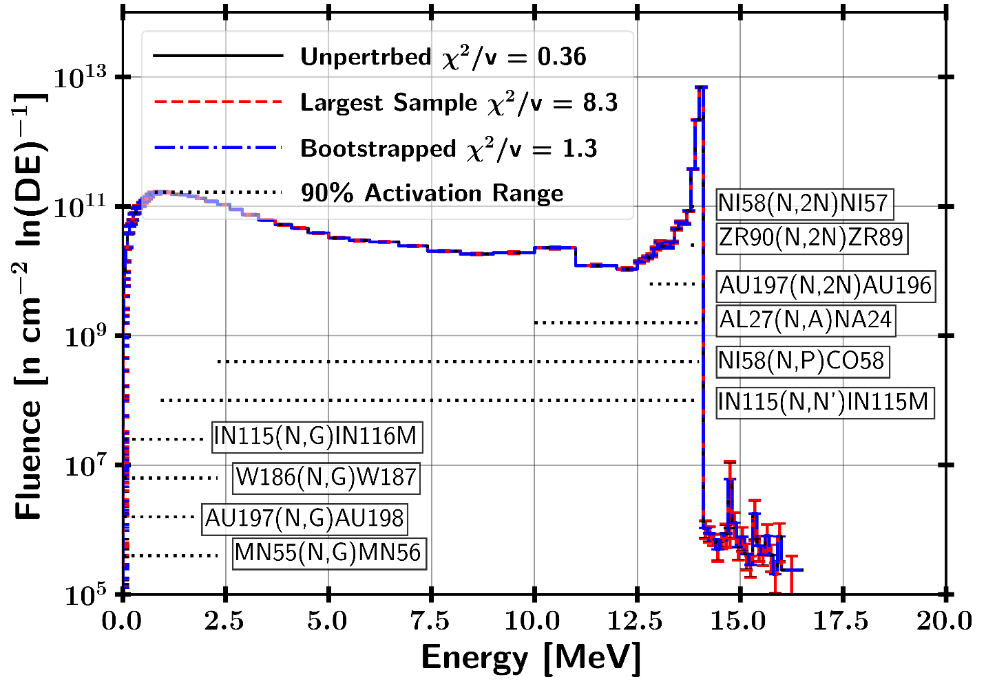
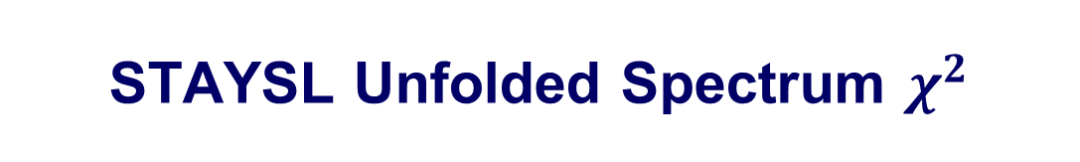
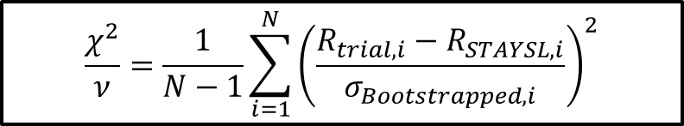
STAYSL Unfolded Spectrum $χ^{2}$
182 Sampled Activation Results
81.9% of samples were not-rejected with a p-value greater than 0.05
18.1% of samples were rejected with a p-value lower than 0.05
H₀ : Two sets of data are governed by the same expected distribution .
$$\frac{χ^{2}}{ν}=\frac{1}{N−1}\sum_{i=1}^{N}{{\left(\frac{R_{trial,i}−R_{STAYSL,i}}{σ_{Bootstrapped,i}}\right)}^{2}}$$

Slide 27
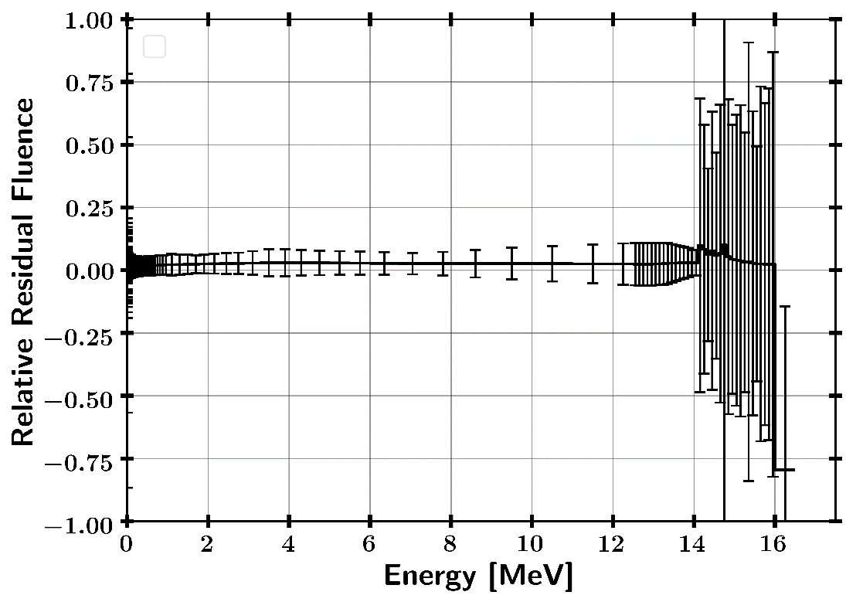
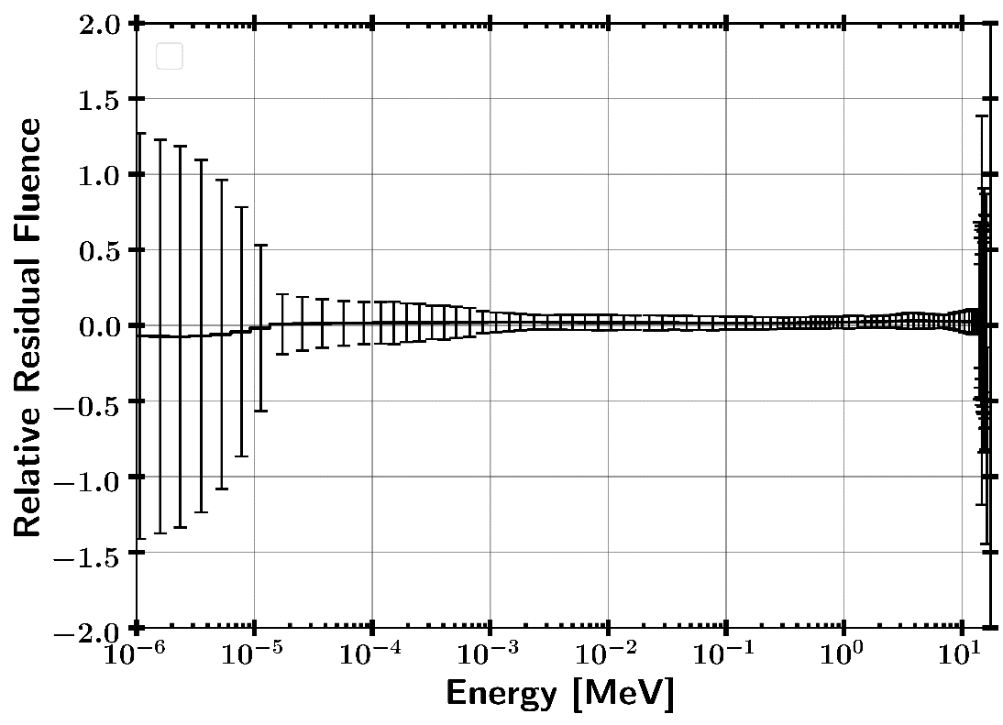
STAYSL Changes to MCNP Guess Neutron Spectrum
Increase in fluence normalization is caused by not entirely homogenous flux in ETA sample cavity

Slide 28
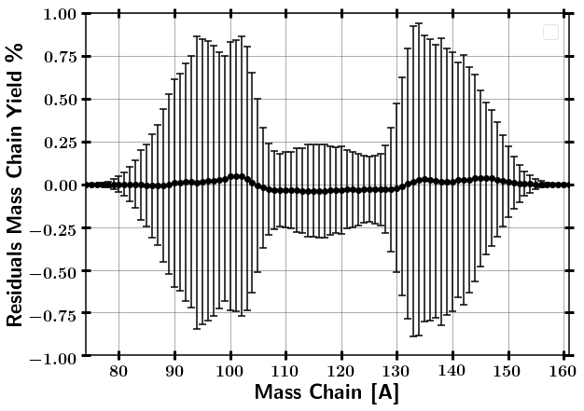
GEF Results
ETA Produced $2∗{10}^{9}±1\%$ fissions
Modeled ETA produced fission products are consistent to predicted TN+PFNS within error.

Slide 29
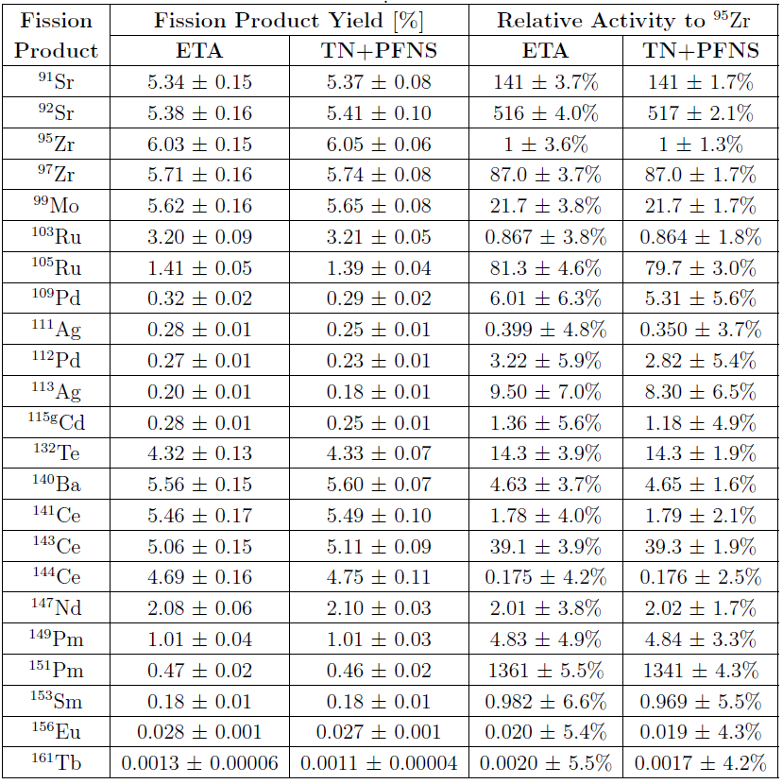
Nagy Fit Results - Predicted Fission Products for Radiochemical Analysis
ETA produced fission products are consistent to predicted TN+PFNS within error.
Lower Uncertainty Nagy results
Well matching on peaks and wings
Larger error in fission product valley isotopes caused by larger high energy neutron flux in ETA

Slide 30


Nagy Fit Results - Predicted Fission Products for Radiochemical Analysis
Cumulative fission products predicted from Nagy fit data can replace GEF results.
All fission products except ¹³²Te are approximate cumulative yields.

Slide 31


Fission Production Capability Perspective
DELFIC
10 KT
1 m HOB
16 Aug 2017
Ground dispersal of mass chain 140
ETA equivalent to $100 cm^{2}$

Slide 32

Conclusions
Provide experimental data to further enable post-detonation attribution through enhanced technical nuclear forensics
Representative neutron environment
Modeled ETA fission products consistent with TN+PFNS
$2 x {10}^{9}±1\%$ fissions (order of ground sample collection)
Moderate impact of nuclear data covariance
~ 1% for integral reactions with low uncertainty (Fluence, ${}_{}^{235}U$ (n,f))
~3-20% for activation foil reactions
Strong probability (80%) of unfolding successfully without iterating
Candidate technology as a short pulse neutron source
Enhanced confidence for Q4 2019 NIF experiment

Slide 33
Questions?

Slide 34
Backups

Slide 35







STAYSL Unfolded Spectrum Pearson Correlation Coefficient and K-S Statistic
182 Sampled Activation Results
0% of samples rejected based on K-S Statistic
$D=0.094$
p-value $=0.61$
182 Sampled Activation Results
0% of samples failed based on Pearson Correlation Coefficient
$r>0.8$
p-value $≪$0.05
Strong agreement between spectra
H₀ : The two samples are drawn from the same distribution.
H₀ : There is no correlation between the datasets.
35

Slide 36

Importance of Source Characterization
Compared 4 sources relative to MCNP5 14.03 MeV neutron point source
Impact of source term
10.75 keV plasma temperature Appelbe distribution point source
14.06 MeV point source
Impact of room return
MCNP SSR
SCALE MAVRIC Mapped SSR

Slide 37


Statistical Analysis Testing
$χ^{2}$
H₀ : Two sets of data are governed by the same expected distribution.
Reject if p-value < 0.05
Pearson r
H₀ : There is no correlation between the datasets.
Reject if p-value > 0.05
Kolmogorov-Smirnov (KS) – 2 Sample
H₀ : The two samples are drawn from the same distribution.
Reject if p-value < 0.05

Slide 38

Previous Work
UC – Berkeley and LLNL developed energy tuning assembly (ETA).
Coeus metaheuristic optimization software package
Validation test at LBNL 88-Inch Cyclotron

Slide 39





Foil Activation
Saturation Activity
Activity Post Irradiation
$t_{i} −$ irradiation time
Short pulse approximation
($t_{i}≪T_{1/2}$)

Slide 40
Innovations
Demonstrated further abilities to incorporate nuclear data covariance into fixed radiation transport simulations
Improved the ability to generate synthetic fission product debris
Advanced the field of neutron spectral shaping for radiation effects testing simulators
Developed methodology for quantifying the neutron flux uncertainty for foil activation unfolding of neutron energy spectra
Contribution to future improvements to SCALE

Slide 41


HEU Fission Spectra
ETA Produced $2∗{10}^{9}±1\%$ fissions

Slide 42







Case study – Impact of weighting function on systematic uncertainty
⁵⁸Ni (n,2n) comparison between SCALE 252 Group and CE
1 n/cm²-s flux scaled by bin width from 12.4 (Threshold) – 14 MeV
Ni-58 (n,2n) SAMPLER Samples
$$Q=Σ_{g}^{∗}/Σ_{g}$$
Sample Cross-section
$R=\sum_{g=1}^{G}{{φ_{g}Σ}_{g}}V Q_{g}$
 | Ratio 252/CE
R/s-cc | 0.9958
$$σ$$ | 1.002
Notes:
Assumed pure ⁵⁸Ni, 1 cc, and N = 10²⁴ at/cc
1 n/cm²-s flux scaled by bin width from 12.4 – 14 MeV

Slide 43






Nuclear Data Covariance
Correlation: $\frac{\left\langle X−μ_{X}\right\rangle \left\langle Y−μ_{y}\right\rangle }{σ_{X}σ_{Y}}$
${}_{}^{235}U \left(n,f\right)$ Correlation Matrix
Covariance: $\left\langle XY\right\rangle − μ_{X}μ_{Y}$
When X=Y:
$$cov\left(X,X\right)=\left\langle X^{2}\right\rangle −{\left\langle X\right\rangle }^{2}=σ_{X}^{2}$$
Multivariate Normal Distribution:
$$Λ=Covariance Matrix$$

Slide 44
Future Work
Q4 2019 Experiment

Slide 45

GEF Results

Slide 46


Residuals SCALE / MCNP

Slide 47

Reaction Convergences

Slide 48


Slide 49

Contributions to Uncertainty

Slide 50
Fission Process
Fission fragments (prompt decay) → Fission Products

Slide 51



Fission Yields
Independent yield
Where, $f\left(A,Z\right)=$ yield of isotope
$Y\left(A\right)=$ sum of all fission products in a mass chain
$R\left(A,Z,I\right)=$production of isomers ratio
Cumulative yield
Where, N channels contribute with
$b_{j}$ branching ratios into the cumulative yield
Cumulative yield is experimentally measured quantity.
Chain yield
Accounts for branching in and out of a mass chain through neutron emission

Slide 52
Fission Yields
U-235 thermal (n,f)

Slide 53


Fission Product Estimation
General Observables of Fission (GEF)
Fit to model (Nagy fits)

Slide 54



Unfolding Solution Methods
Matrix inversion
Least-square spectral adjustment (ex. PNNL STAYSL)
Incorporates uncertainty and an can incorporate covariance
Requires guess spectrum
Stochastic methods
P = Neutron flux and nuclear data
A = Activity
N =Covariance

Slide 55
Nuclear Data Uncertainty

Slide 56

Options to Generate Representative Nuclear Weapon Environments
Synthetic Fission Debris
Sample doping
Direct production using fission converters
Surrogate methods
Spectral modification
Neutron Effects on Electronics
Utilize existing sources
Models
Surrogate charged particle reactions

Slide 57

Neutron interactions relevant to ETA design

Slide 58

Scope of Nuclear Weapons Effects Testing Simulators
Notes:
\ Representative nuclear weapons system and effects testing is carried out through various organizations in the Department of Energy (DOE), Department of Defense (DOD), and supporting organizations. The scope of the testing sites is incredibly wide, ranging from radio frequency communications to the prompt gamma and neutron emissions following a nuclear event. A summary of some of the nuclear weapons effects testing simulation and facility capabilities is shown in Table \ref{tab:NWECap}.

Slide 59

Neutron Flux Unfolding
If you knew everything… it is just doing a matrix inversion of the reaction group averaged cross-section.
Reaction Matrix [cm^2] Flux [n/cm^2-s] Reaction Rate [1/s]
(n,g)
(n,n’)
(n,2n)
(n,2n)
$\left[\begin{matrix}20 & 10 & 1 \\ 0 & 1 & 2 \\ 0 & 0 & 1 \\ 0 & 0 & 0\end{matrix} \begin{matrix}0 \\ 0.3 \\ 2 \\ 3\end{matrix}\right]\left[\begin{matrix}6.1 \\ −16 \\ 8.3 \\ 3.3\end{matrix}\right]$ = $\left[\begin{matrix}0.75 \\ 1.75 \\ 15 \\ 10\end{matrix}\right]$
Does not work because:
Measurement Error
Too broad of bin structure
Not enough reactions
Adding too many foils to create a large bin structure is counter to being optically thin

Slide 60


Selected Activation Foil Uncertainties
Au-197 (n,g) Mn-55 (n,g)

Slide 61

Mn-55 log-normal

Slide 62

Appelbe 10.75 keV

Slide 63


Nagy Fit – parameters

Slide 64

STAYSL – Unfolds Compared to TN+PFNS

